Slide 1
Feature Extraction and Price Prediction for Mobile Phones

Slide 2
Project Description
In this project, we will work with a dataset that contains detailed information about various mobile phones, including their model, color, memory, RAM, battery capacity, rear camera specifications, front camera specifications, presence of AI lens, mobile height, processor, and, most importantly, the price. our primary goal is to develop a predictive model for mobile phone prices.

Slide 3
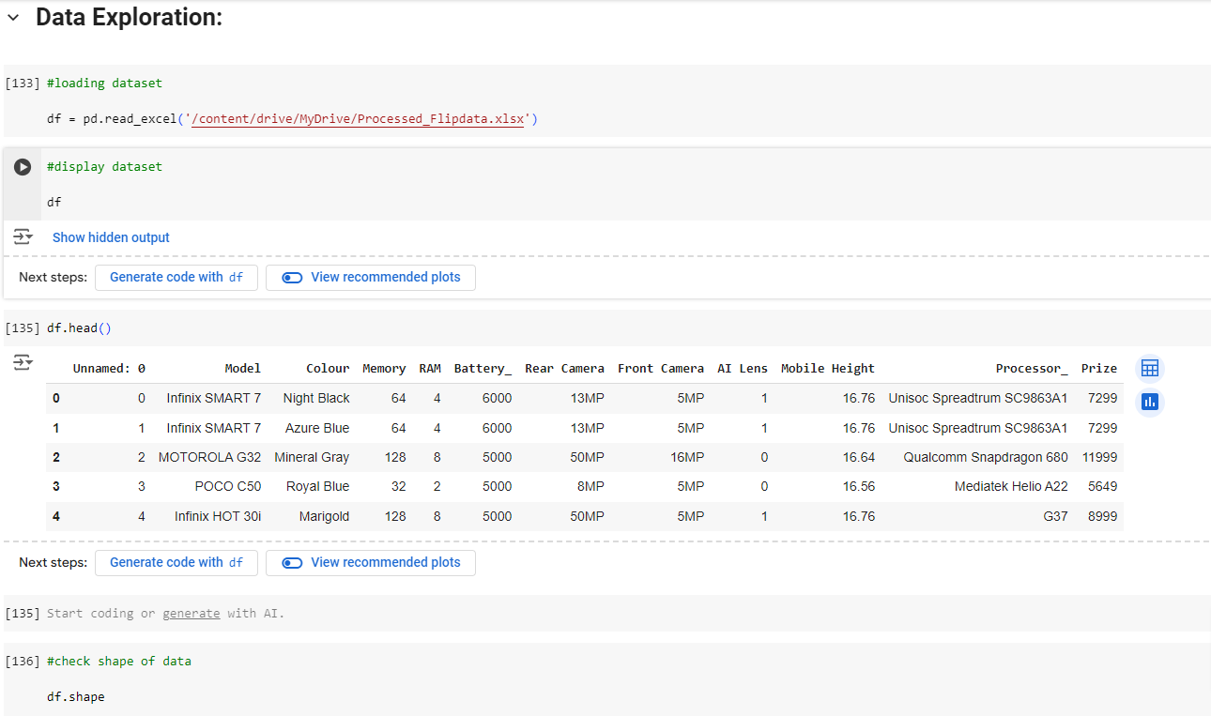
Data Exploration
Imported libraries.
Loaded dataset using pandas.
Displayed first few rows of the dataset.
Checked the shape of the dataset (number of rows and columns).

Slide 4
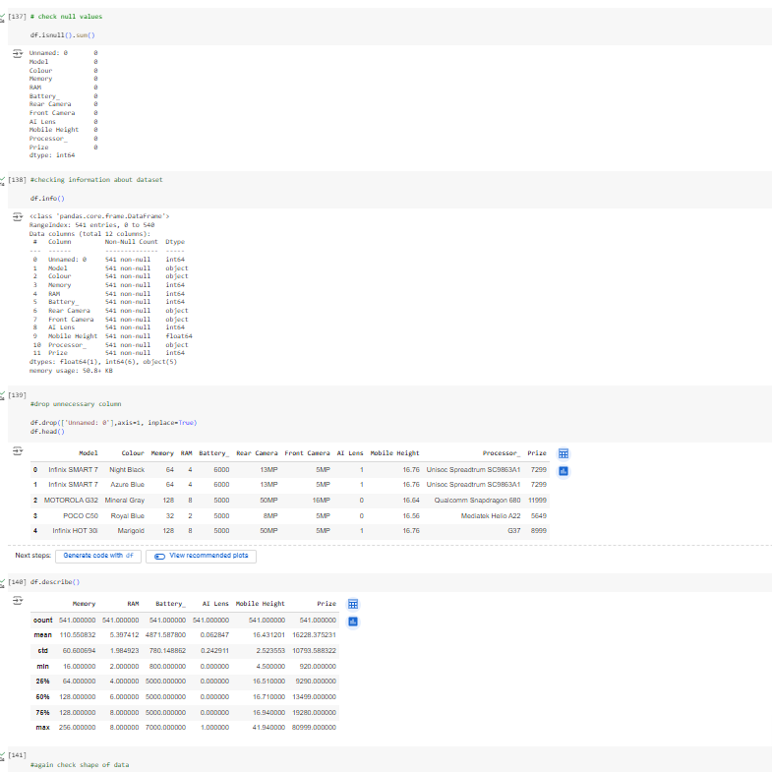
Data Cleaning
Checked for null values in the dataset.
Dropped unnecessary columns.
Described the dataset for basic statistical overview.

Slide 5
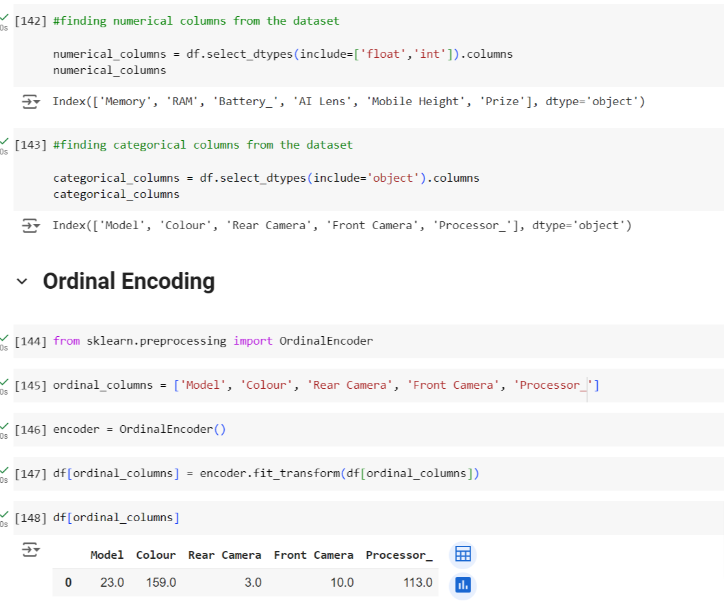
Data Preprocessing
Identified numerical and categorical columns.
Performed ordinal encoding on categorical columns.

Slide 6
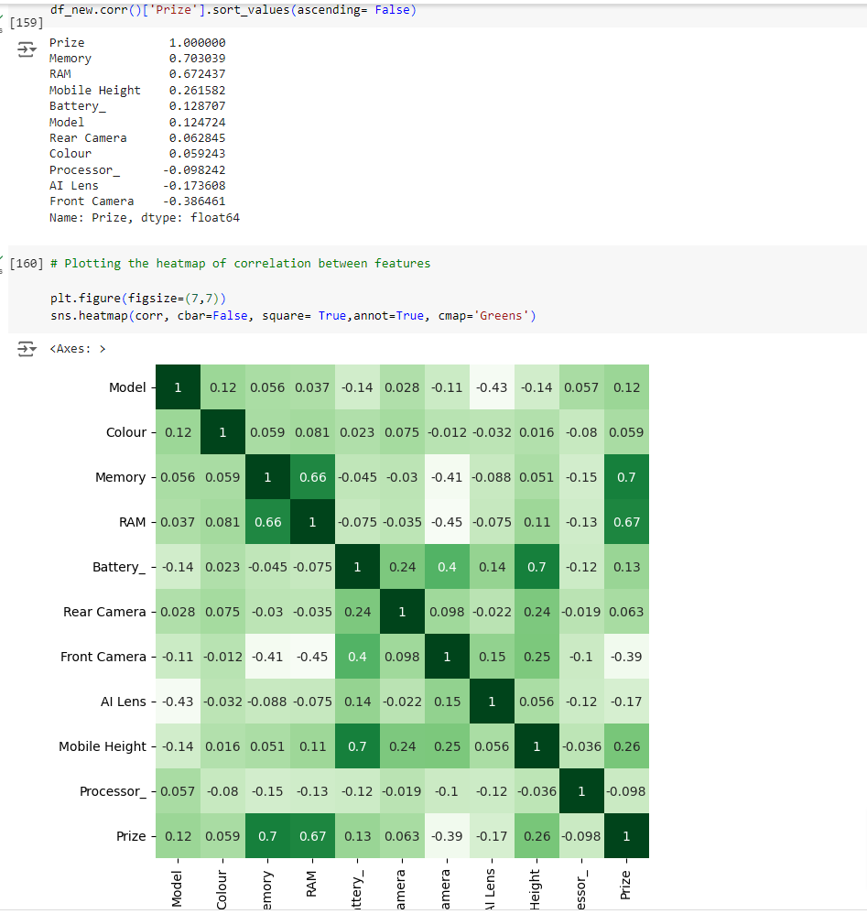
Feature Extraction
Visualized correlation matrix using a heatmap.
Highlighted key correlations with the target variable (price).

Slide 7
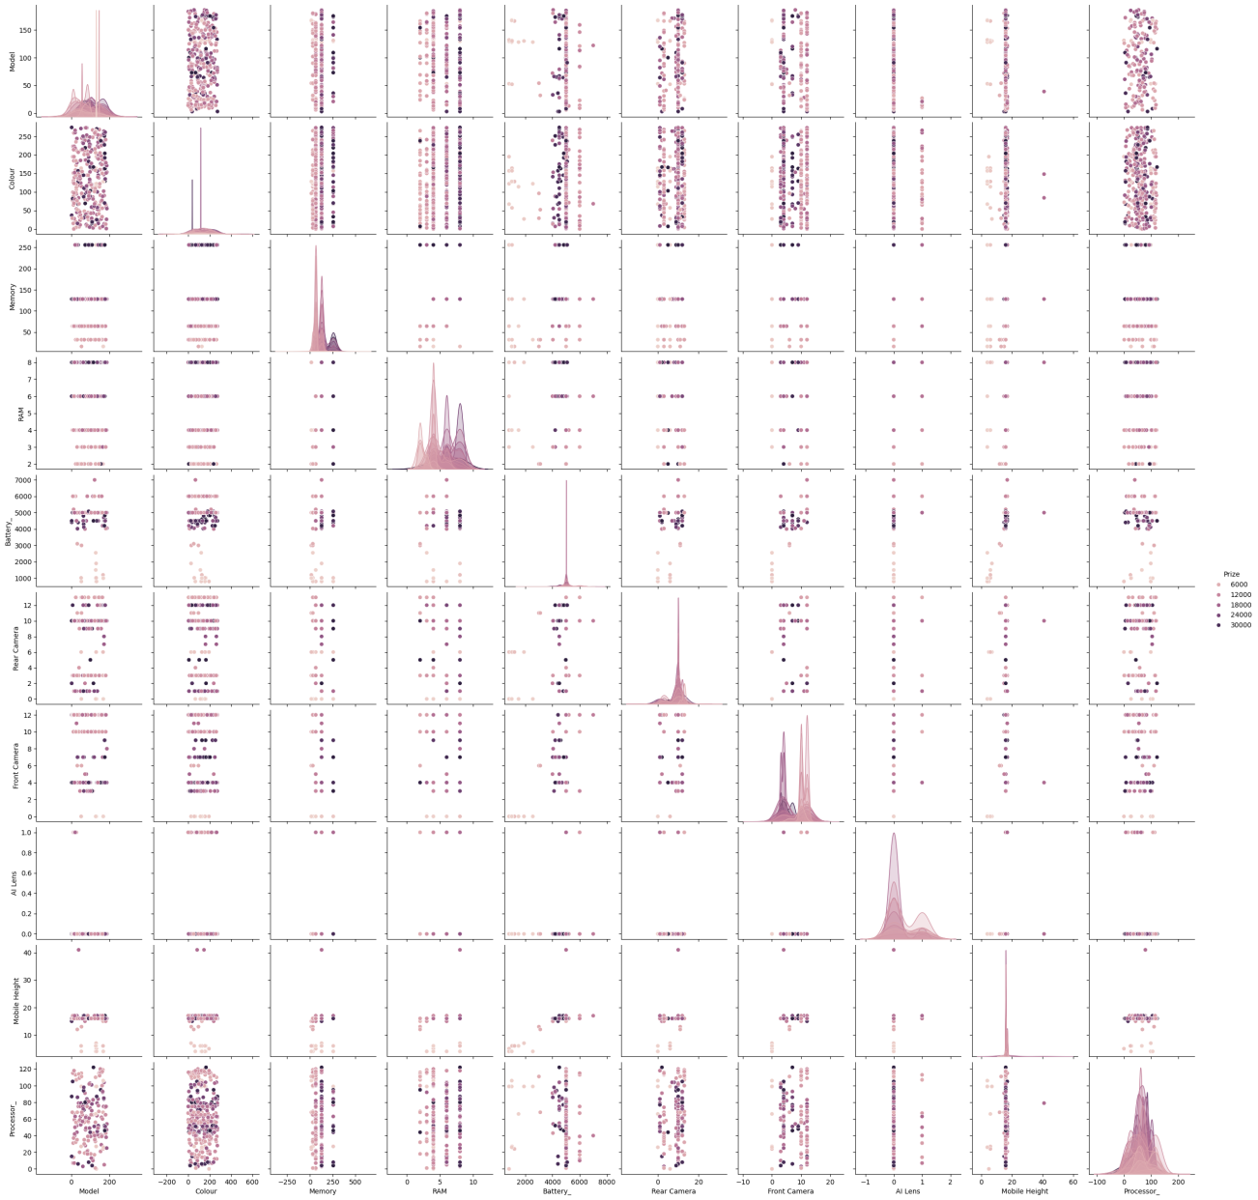
Exploratory Data Analysis (EDA)
Visualizations: Pairplot.

Slide 8
Pairplot Outcome: The plot shows that there is a positive correlation between the price of a phone and the following features:
Processor: Phones with higher processor scores tend to be more expensive.
Battery: Phones with larger batteries tend to be more expensive.
Rear camera: Phones with higher rear camera megapixels tend to be more expensive.
Front camera: Phones with higher front camera megapixels tend to be more expensive.
Memory: Phones with more memory tend to be more expensive.
Overall, the plot suggests that there are several factors that contribute to the price of a mobile phone. Phones with better features, such as a higher processor, more memory, and a better camera, tend to be more expensive.

Slide 9
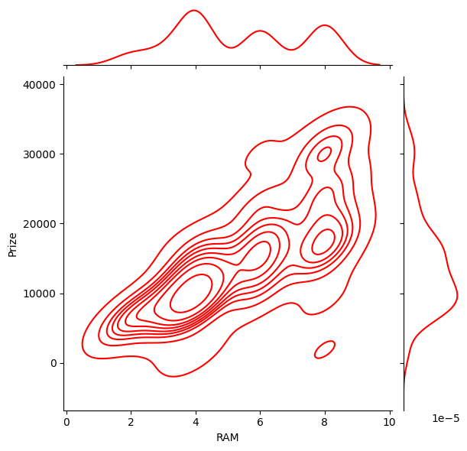
Jointplot for RAM vs. Price.
Outcome: This is a jointplot showing the relationship between RAM and Prize. The plot shows a strong positive correlation between RAM and Price. As RAM increases, the price of the device also increases. This indicates that RAM is a significant factor influencing the price of a device.

Slide 10
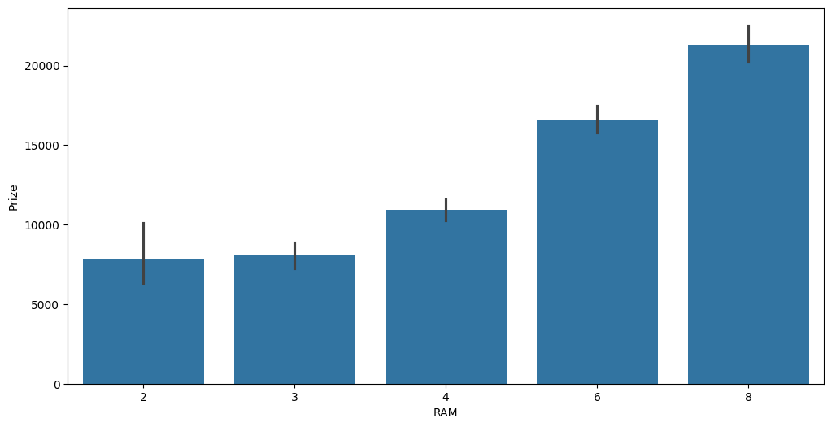
barplot for RAM vs. Price.
Outcome: The chart shows that laptops with higher RAM sizes have higher average prices. The average price increases with increasing RAM size. The error bars represent the standard deviation of the price for each RAM size.

Slide 11
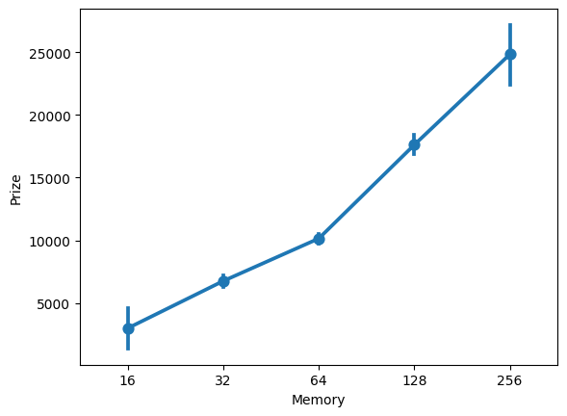
Pointplot for Memory vs. Price.
Outcome: The plot shows the relationship between the amount of memory and the prize. There is a positive correlation between the two. As the amount of memory increases, the prize increases. The relationship is not linear, but rather has a slightly curved shape.

Slide 12
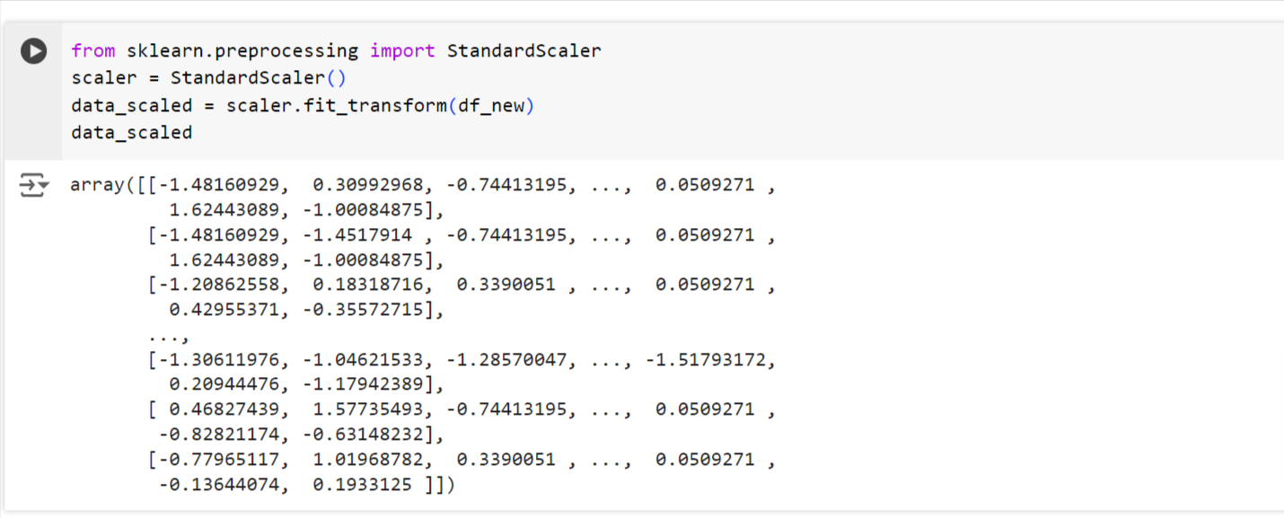
Feature Scaling

Slide 13
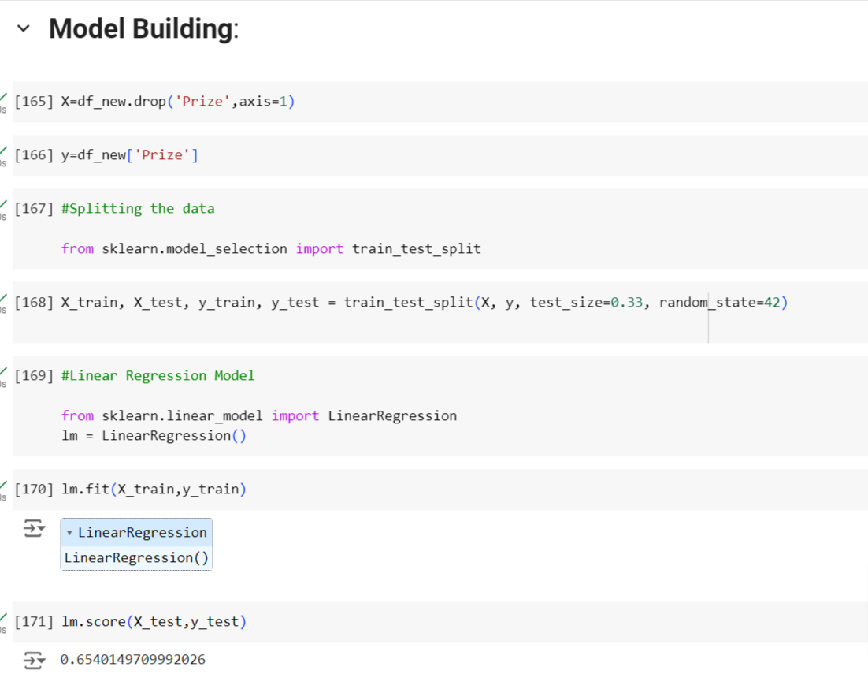
Model Building
Linear Regression :

Slide 14
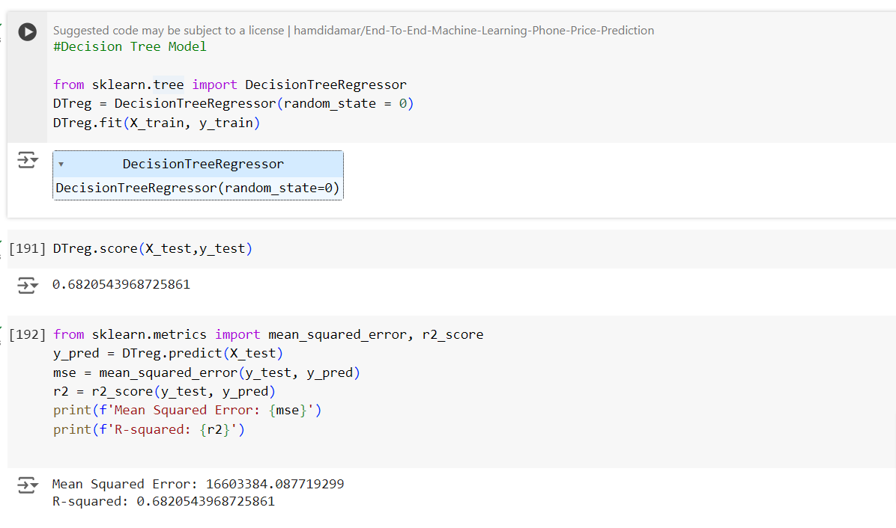
Decision Tree Regressor :

Slide 15
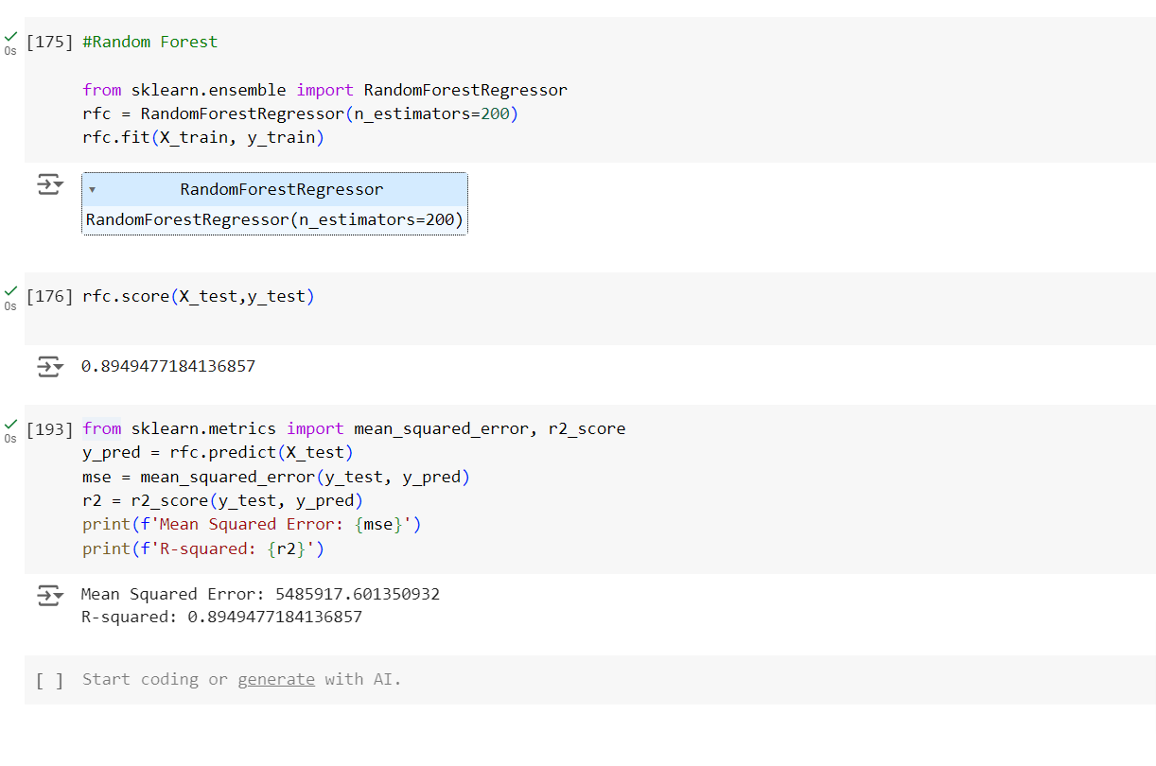
Random Forest Regressor :
Outcome : we got best score from Random Forest Regressor
0.8949477

Slide 16
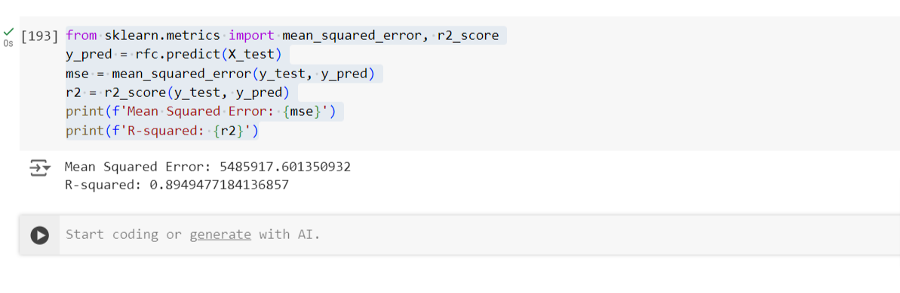
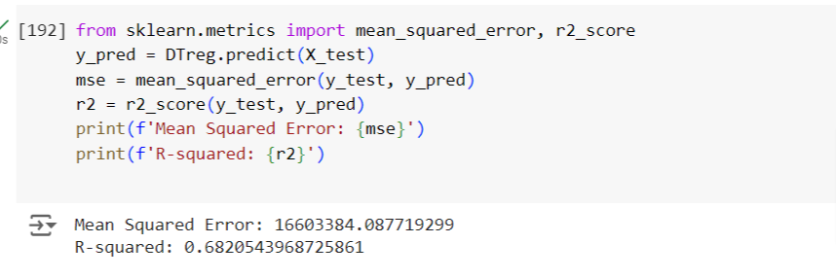
Model Evaluation
Random Forest
Regressor :
Decision Tree
Regressor :

Slide 17
Conclusion
As we can see the price of a mobile phone is directly proportional to its memory capacity. As the memory capacity of the mobile phone increases, the price also increases.there is a strong positive correlation of prize with two variables Memory and RAM.
This conclusion can be used to predict the price of a mobile phone based on its memory capacity and RAM. For example, if a new mobile phone with 512GB of memory is released, its price can be predicted to be higher than 25000.
if a new mobile phone with 8GB of RAM, its price can be predicted to be higher than 20000

Slide 18


